Slide 1
Writing Maintainable Rails Applications
Chris Cumming
Notes:
Small talk. Make sure everyone can see the slides and hear me. Allow a couple minutes for late-comers.

Slide 2



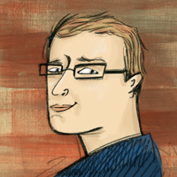
Who am I? (i.e. Shameless Self Promotion)
Software Consultant https://saturdaymp.com chris.cumming@satudaymp.com Virtual Chat Host http://weeklydevchat.com/ https://www.legacycode.rocks/
Slacks Chris C on Dev Edmonton (https://devedmonton.com/) Legacy Code Rocks (https://www.legacycode.rocks/) YegSec (https://www.yegsec.ca/)
Notes:
Software consultant.

Slide 3
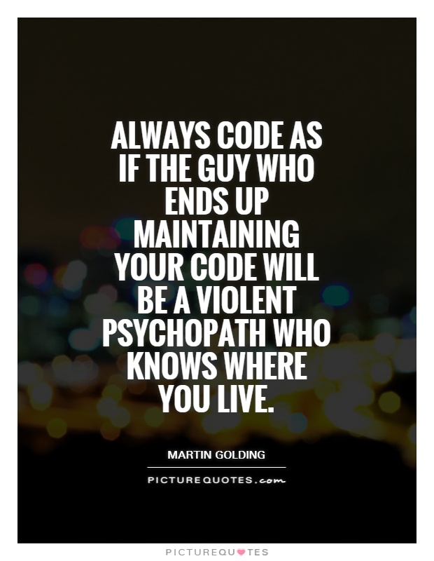
What is Maintainable Software?
"The ease with which a software system or component can be modified to correct faults, improve performance or other attributes, or adapt to a changed environment."
IEEE
“Would you be willing to be paid by the release but have your payment reduced for every issue found?”
Chris
Notes:
Couldn’t access the IEEE glossary but found it posted in multiple locations on the web.

Slide 4
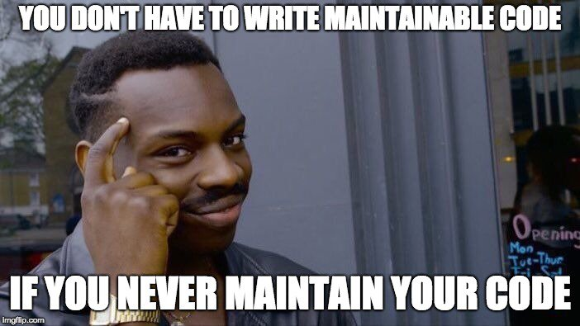
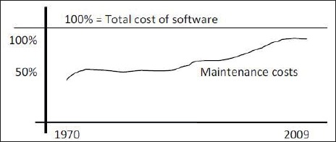
Why Write Maintainable Applications?
Applications live for a long time
Written once, read, changed and refactored multiple times
Cost of maintenance is increasing https://www.ncbi.nlm.nih.gov/pmc/articles/PMC3610582/
It is the right thing to do (or be a professional)

Slide 5
Traits of Easy to Maintain Application
Well written and architected
Good test coverage
Uses guardrails
Problems are found early and are hard to ignore
Explicit
Feel confident making changes
Notes:
Well written and architected
Coding style
Modular
Good test coverage
Automated tests (unit, integration, system, etc)
Not 100% but high and covers critical paths.
Guard Rails
Strong typing
Linters
Type checkers
Errors found ASAP
Finding potential issues in development is better than CI, better then staging, and better then production.
Explicit
Clear what is happening and why
No magic
Explicit links and references

Slide 6
Well Written and Architected
Rails has well defined file locations and naming scheme, follow them.
Rails has well known idioms, use them.
Keep MVC logic in the correct location.
Avoid fat controllers and models.
Don’t be afraid to put logic in non-controller/model classes.
Don’t do queries or complicated logic in views.
Notes:
Rails is pretty good at directing you to well written and architected applications.
Move logic from models to services, or other appropriate classes. Have classes that deal with multiple models.
Queries are done in controller, complicated logic in helper or other appropriate class.
SOLID
The Single-responsibility principle: "There should never be more than one reason for a class to change."^{[5]} In other words, every class should have only one responsibility.^{[6]}
The Open–closed principle: "Software entities ... should be open for extension, but closed for modification."^{[7]}
The Liskov substitution principle: "Functions that use pointers or references to base classes must be able to use objects of derived classes without knowing it."^{[8]} See also design by contract.^{[8]}
The Interface segregation principle: "Clients should not be forced to depend upon interfaces that they do not use."^{[9][4]}
The Dependency inversion principle: "Depend upon abstractions, [not] concretions."^{[10][4]}

Slide 7
Good Test Coverage
Easy to write and run tests in Rails, no excuse not too.
Monitor test coverage (e.g. SimpleCov) percentage in CI and fail build if it goes down.
Don’t be afraid to test views, partials, routes, etc.
Only use Mocks as a last resort. VCR can mock 3rd party API calls.
Have both unit and system tests.
Notes:
Rails comes with MiniTest and it’s easy to add RSpec. Also easy to add other testing helps such as FactoryBot, Faker, etc.
Unit test all parts of the system.
VCR to mock out 3rd party API calls.
System tests as a user clicking on stuff. RSpec or Cucumber. Unit tests should be fast, system tests can be slow.

Slide 8
Uses Guardrails
Ruby and Rails does not have many guardrails, you need to add them.
Use a linter like Standard or RuboCop. Fail build if linter finds an issue.
Use a type checker like Sorbet. Fail build type checker finds an issue.
Use IDE code inspections.
PR reviews.

Slide 9
Problems are Found Early and are Hard to Ignore
Run linter, type checker, tests, etc before committing code.
Visual diff your changes before committing.
CI should run linter, type checker, tests, test coverage, etc. Should notify developer if a check fails.
Don’t do PR reviews until all checks pass.

Slide 10
Explicit
Ruby on Rails is not great at being explicit.
Use Sorbet, or other type checker.
Avoid metaprogramming (defining methods on the fly) and duck typing.
Systematically remove code. https://thepugautomatic.com/2020/11/systematically-removing-code/
Use tools to find dead code. https://www.hexdevs.com/posts/how-to-remove-dead-code-ruby/
Use Comments.

Slide 11
Feel Confident Making Changes
Do you feel comfortable making the change?
Will take time to build up your confidence.
You will never catch all issues. Add additional checks for bugs that slip through the cracks.

Slide 12
Questions?
Email: chris.cumming@satudaymp.com
Slacks Chris C on Dev Edmonton (https://devedmonton.com/) Legacy Code Rocks (https://www.legacycode.rocks/) YegSec (https://www.yegsec.ca/)

Slide 13
Resources/References - 1
Buggy Code: 10 Common Rails Programming Mistakes https://www.toptal.com/ruby-on-rails/top-10-mistakes-that-rails-programmers-make SimpleCov https://github.com/simplecov-ruby/simplecov
RSpec https://rspec.info/
Sorbet https://sorbet.org/
RubyMine https://www.jetbrains.com/ruby/

Slide 14
Resources/References - 2
Systematically remove code. https://thepugautomatic.com/2020/11/systematically-removing-code/
Use tools to find dead code. https://www.hexdevs.com/posts/how-to-remove-dead-code-ruby/
Standard: https://github.com/testdouble/standard

